Slide 1
Email, Mobile and Video Marketing
Dr. Avinash Panwar

Slide 2
What is email marketing?
It is a highly effective digital marketing strategy of sending emails to prospects and customers.
Effective marketing emails convert prospects into customers, and turn one-time buyers into loyal fans.

Slide 3
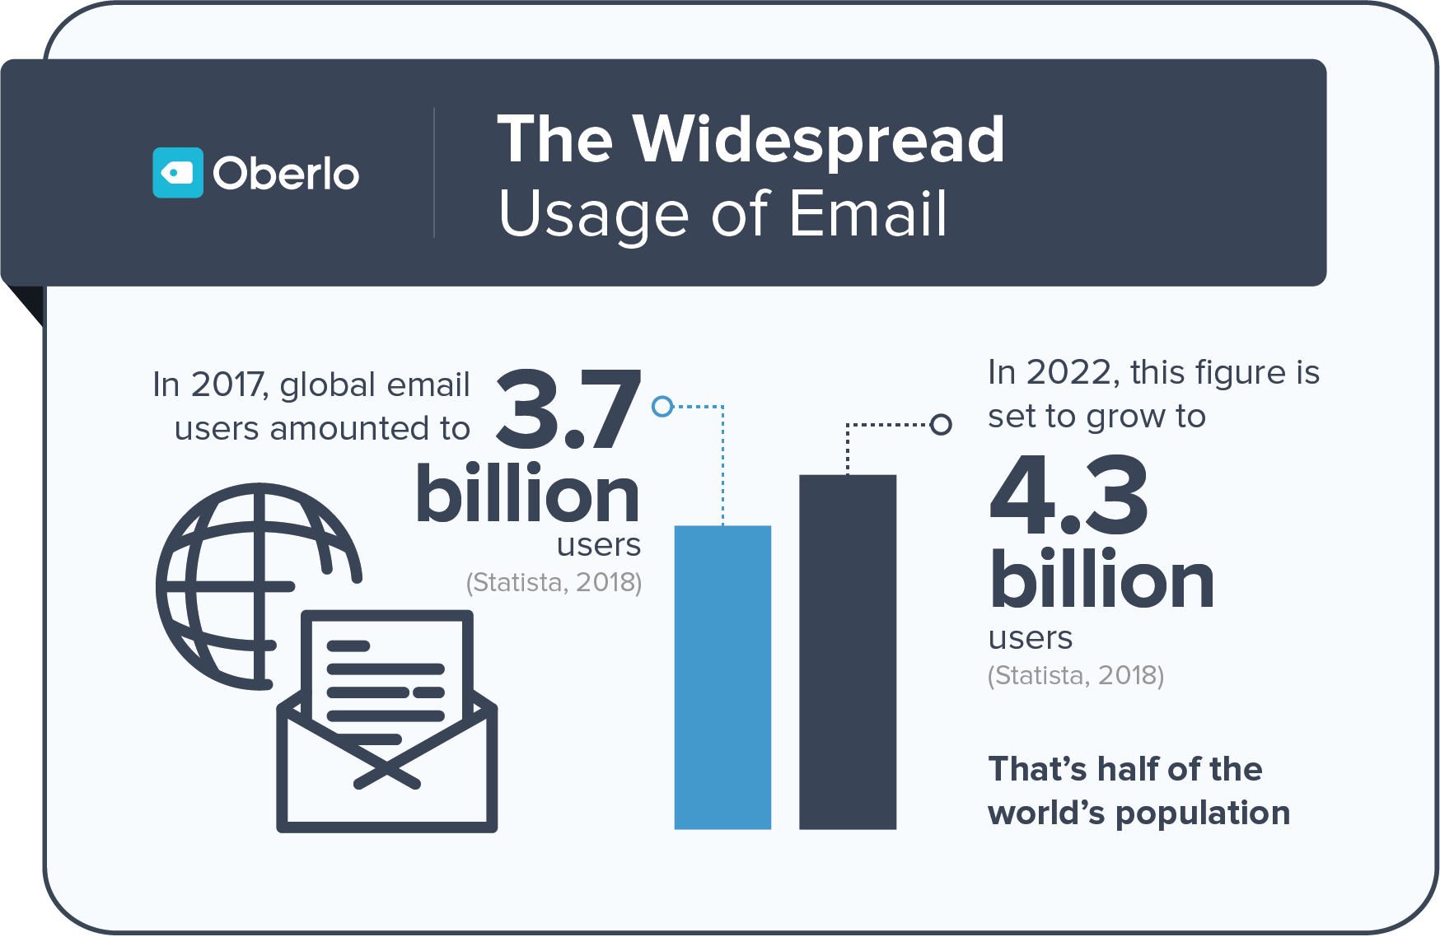
Importance of email marketing
Widespread usage of email
Source: https://www.oberlo.in/blog/email-marketing-statistics

Slide 4
Importance of email marketing
It is cost effective, measurable and easily shareable
Improves brand awareness.
Flexible design as you can send text, images, and attach files
Scalability for large audiences.
It is less intrusive than phone marketing and green friendlier than postal marketing.

Slide 5
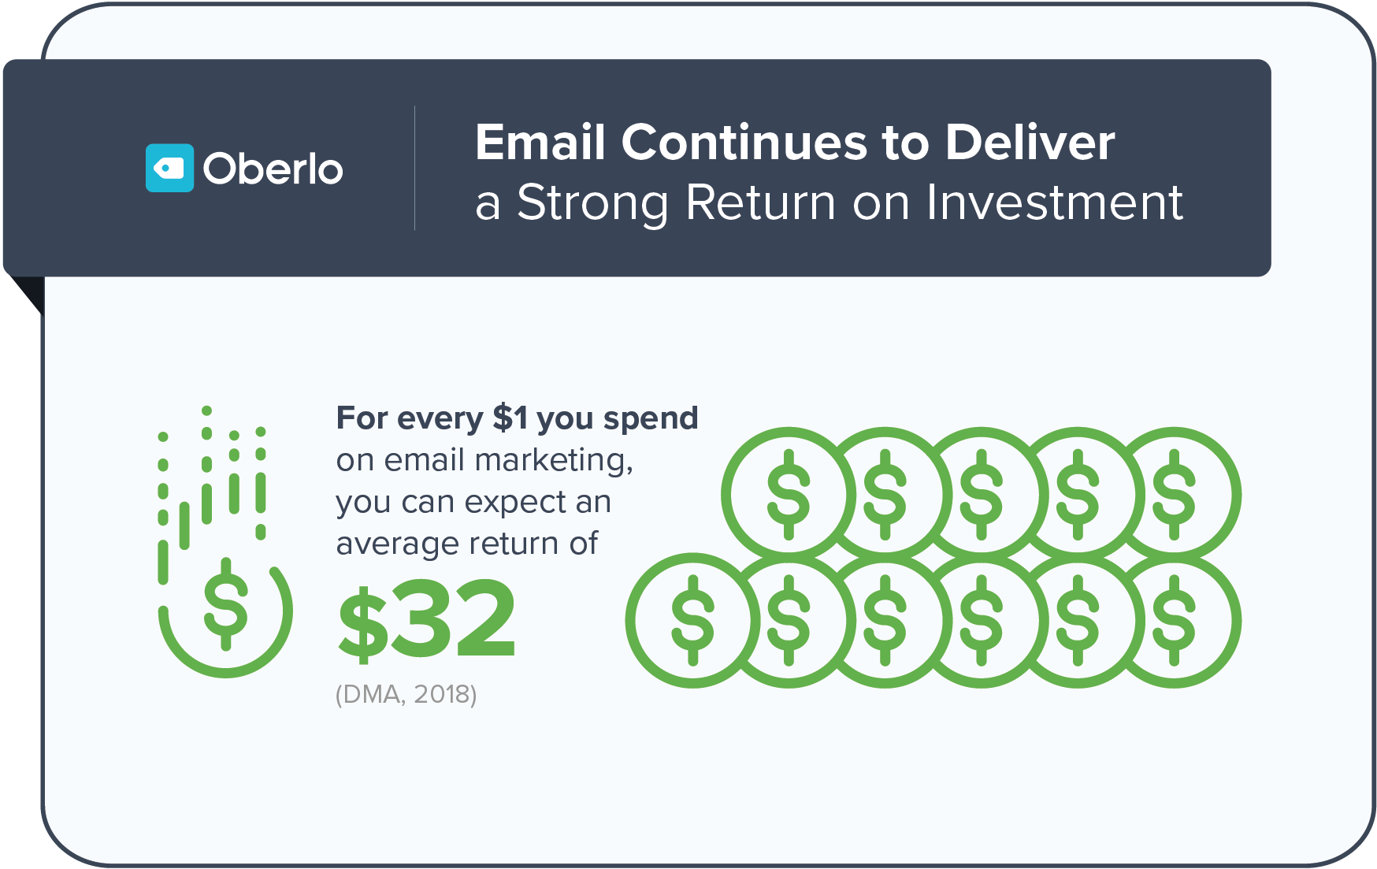
Importance of email marketing
Email Continues to Deliver a Strong Return on Investment
Source: https://www.oberlo.in/blog/email-marketing-statistics

Slide 6
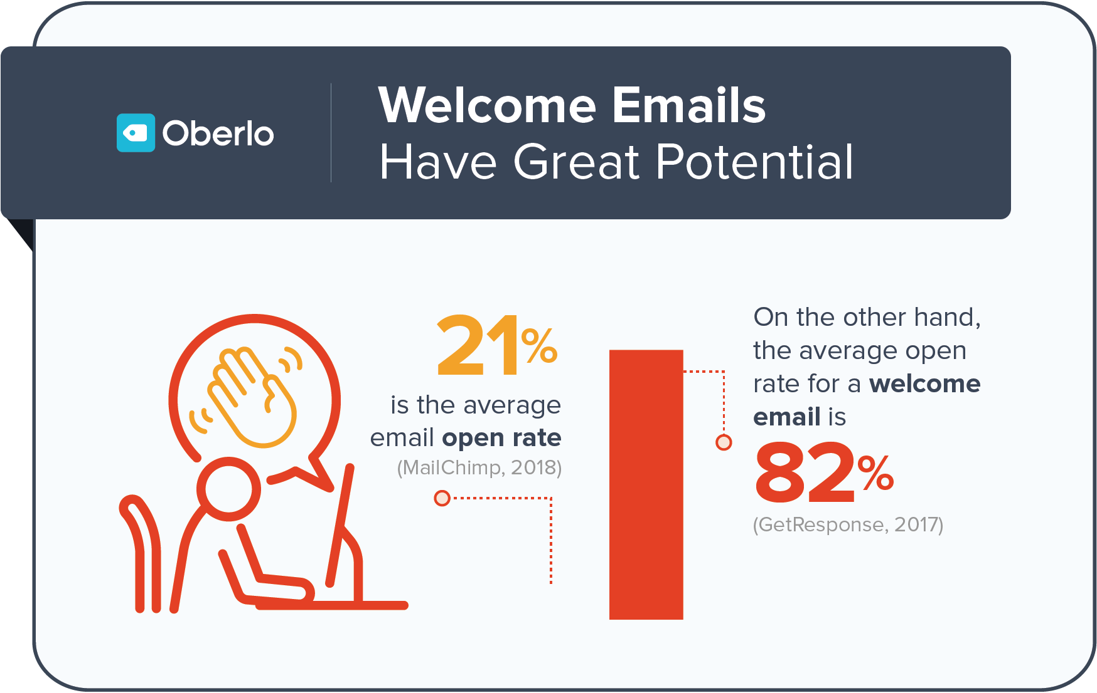
Importance of email marketing
Welcome Emails Have Great Potential
Source: https://www.oberlo.in/blog/email-marketing-statistics

Slide 7
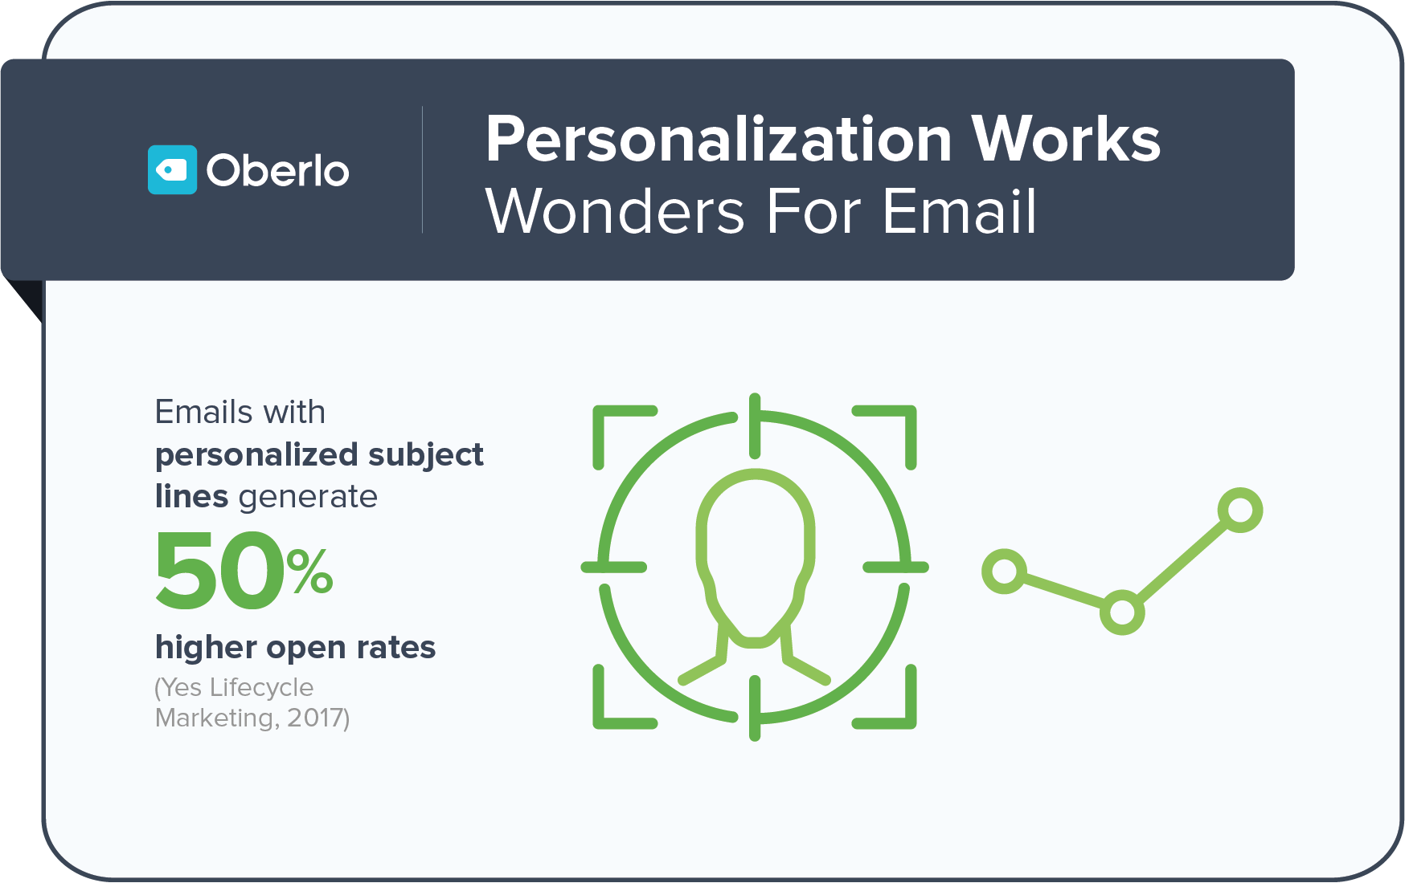
Importance of email marketing
Can send personalized messages to target customer segments
Personalization delivers better results
Source: https://www.oberlo.in/blog/email-marketing-statistics

Slide 8
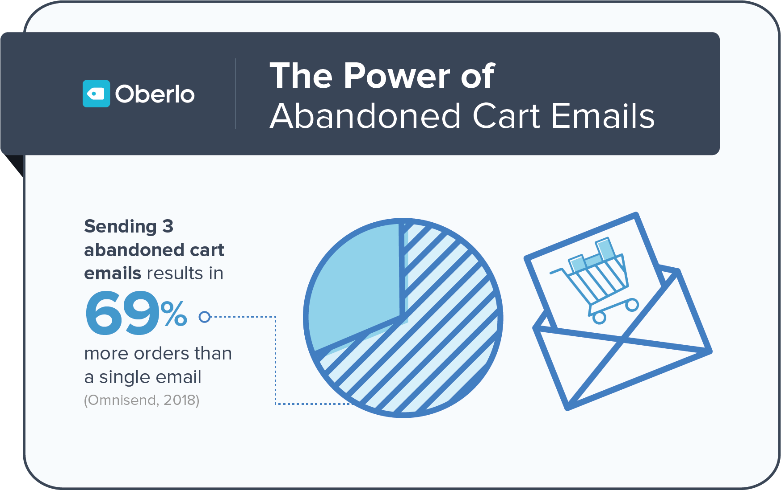
Importance of email marketing
Customers with abandoned shopping carts can be easily converted
Source: https://www.oberlo.in/blog/email-marketing-statistics

Slide 9
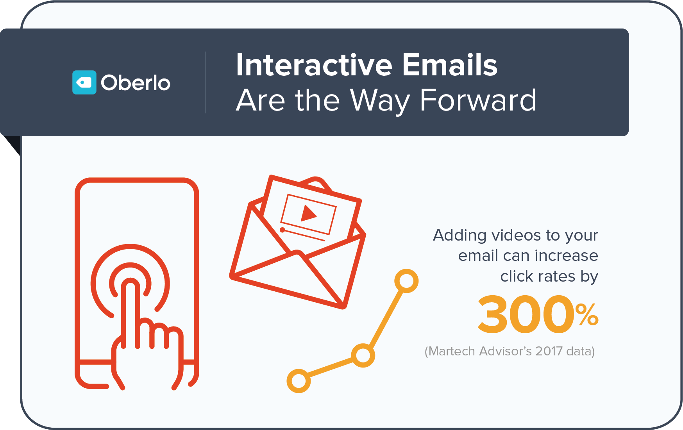
Importance of email marketing
Interactive emails enhance the click rates
Source: https://www.oberlo.in/blog/email-marketing-statistics

Slide 10
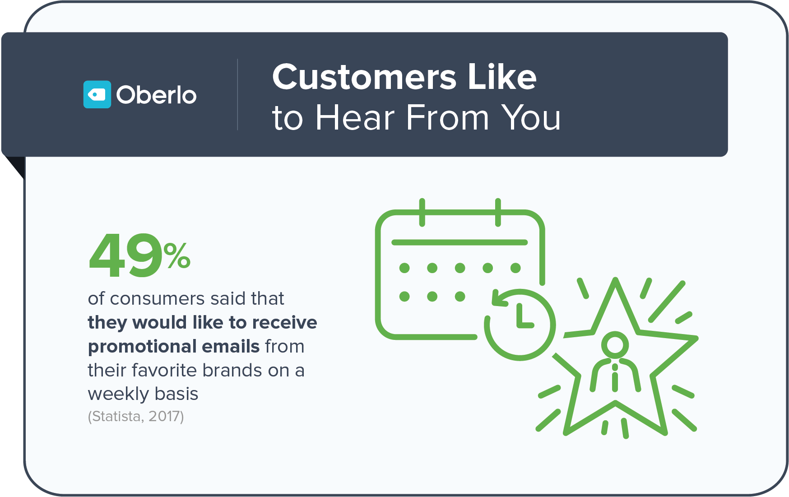
Importance of email marketing
Customers Like to Hear From their Favorite brands
Source: https://www.oberlo.in/blog/email-marketing-statistics

Slide 11
Email Marketing Software
Email marketing packages that are customized as per business size and needs.
Range from basic text-based email editors to fully designed HTML or JavaScript templates.
Price ranges from about Rs300 per month to as much as Rs1200 per month for a range of features.
Two categories:
1. Pure-play email marketing services : Mostly used for one-time communications. For example, an automated email response when they join a subscriber list, on their birthday, or when you promote a new product. E.g. MailChimp
2. Marketing Automation tools: A more complex tool that can build comprehensive workflows designed to automate the email marketing process through prolonged, email-based interactions. For example, to guide someone from a subscriber list to a product purchase. Or you can send thank you emails or send new product promotions. E.g. Hubspot

Slide 12
Email marketing software
Features:
Managing subscribers list: Allow to manage contacts by simply keeping a list of names and email addresses or can create a complex database full of subscribers segmented by demographic slices and engagement levels.
Some software allow to import Gmail and other webmail contacts, and customer relationship management (CRM) data stored on other software.
Building an email newsletter: you can import your own HTML, start from scratch, or use a pre-designed template. Most of these services have drag-and-drop UIs that let you choose exactly the elements you want to include, as well as image libraries
Tools to test your emails for spam: Identifying usage of terms that may send the email into subscribers' junk folders or get your emails banned before they ever reach their recipients.

Slide 13
Email marketing software
Features:
Email auto-responders: offer custom auto-responders which help you stay in touch with your contacts with automatically generated emails based on special occasions (such as their birthday or anniversary), welcome emails for new subscribers, or thank you emails for recent purchases.
Custom workflows: you can specify triggers based on actions (such as opening an email or making a purchase) or on inaction (such as ignoring emails). With these services, you can also set up a series of emails (such as tutorials) to be sent to segments of users, and you can pause or stop a campaign at any time.
Campaign Tracking: you can track your successes and failures and make adjustments based on your learnings. E.g. simple open and click rate data, color-coded charts and statistics, or even integration with Google Analytics.
Integration with other communication-based tools, such as social media management and web analytics software.

Slide 14
Popular email marketing software
HUBSPOT
Pros: Marketing automation. Easy workflow creation. Nice set of pre-built workflows. Works smoothly with related CRM and Sales tools.
Cons: Workflows based on yes or no propositions only. Could use deeper search and SEO-based marketing utilities. Very expensive.
MAILCHIMP
Pros: Email builder. Excellent how-to materials. A wealth of third-party integrations. Affordable plans at every level, including a free plan.
Cons: Reports don't automatically refresh. Pricing plans can be confusing.
CAMPAIGN MONITOR
Pros: Easy to use. Attractive email builder. Excellent array of autoresponders.
Cons: Doesn't offer any phone or chat support. Difficult contact importing.
ZOHO CAMPAIGNS
Pros: Some good yet basic marketing automation features provided. A solid number of autoresponders and email workflows given. Free version offered.
Cons: Templates need improving. Outdated user interface.
Source: https://in.pcmag.com/e-mail/37054/the-best-email-marketing-software

Slide 15
Email marketing campaign
An email marketing campaign is an email sent from a business to one or more customers or prospects. A successful email marketing campaign will get the recipients to take action, engage with your business, and help you to get more leads and sales.
Steps:
1. Define your audience
Use Signup forms to collect information about the audience. Data such as age, gender, interests and subscription preferences..
2. Signup sources
Know how and where subscribers sign up for your list to get a better idea of how to communicate with them and where you might want to focus your marketing efforts going forward.
Notes:
2. Signup sources
Know how and where subscribers sign up for your list to get a better idea of how to communicate with them and where you might want to focus your marketing efforts going forward.
For example, if you see that the majority of your signups are being generated from forms you’ve shared on Facebook and Twitter, then you might want to focus on connecting with your customers—and potential customers—through social media. You can even create segments to target people who joined your list through a specific method, whether it’s an integration like Facebook, an app , an e-commerce integration, or a hosted form.

Slide 16
Email marketing campaign
3. Segments and groups
Create custom segments from data you’ve collected for your subscribers—like e-commerce activity and email engagement.
Examples:
New subscribers – e.g. send new subscribers a welcome email, or a welcome series.
Preferences – e.g. subscribers who want to hear about blog posts vs. those who only want sale notifications.
Interests – e.g. subscribers who like classical music vs. those who like pop.
Location – e.g. notify subscribers who live in the area about your local event.
Open rate – e.g. reward your more engaged subscribers with a special offer just for them.
Inactivity – e.g. remind subscribers who haven’t engaged for a while of the next step you want them to take.
Lead magnet – e.g. send targeted emails based on the topic of the lead magnet that they opted in for.(a lead magnet is something that you give away for free in exchange for an email address)
Shopping Cart Abandonment – e.g. remind subscribers who put items in their cart that they haven’t checked out yet.
4. Personalization is the key
Email list segmentation helps to send more personalized and relevant emails.
Notes:
2. Signup sources
Know how and where subscribers sign up for your list to get a better idea of how to communicate with them and where you might want to focus your marketing efforts going forward.
For example, if you see that the majority of your signups are being generated from forms you’ve shared on Facebook and Twitter, then you might want to focus on connecting with your customers—and potential customers—through social media. You can even create segments to target people who joined your list through a specific method, whether it’s an integration like Facebook, an app , an e-commerce integration, or a hosted form.

Slide 17
Email marketing campaign
5. Develop a content strategy
Send emails with purpose, that really speak to your subscribers, so always keep in mind what they signed up for.
Plan some general content types you can include in your campaigns, so you can refer to it when designing your emails. For example:
Upcoming events
Recaps and photos from previous events
Popular posts from social media, like Instagram or Facebook
News coverage
Details about featured or new products
Holiday shopping guides
Content tips to follow:
Offer value to your subscribers
Keep it useful
Show some personality
Keep it short
Get inspired

Slide 18
Email marketing campaign
6. Establish sending frequency and goals
Make a schedule if you think your sending frequency will change for special events and holidays—
7. Designing emails
Focus on your message and keep your design straightforward.
Lay out all the elements for your campaign in a hierarchy, putting your most important information or the main takeaway toward the top so people can quickly scan your email if they’re short on time.
Make your campaigns as easy to read as possible by dividing text into sections
Choosing legible fonts within the 14-16px range
Adding a call to action.

Slide 19
Email marketing campaign
8. Test your campaigns
Test in different email clients and ISPs
Send test emails to friends and coworkers
9. Email delivery and avoiding spam filters
Factors that can impact how much time it takes for your campaign to be delivered:
reputation of the sending server, the campaign’s content, and the receiving servers.
Ensure that the content is compliant with generic terms of use and consistent with your brand to avoid spam filters and firewalls when they reach receiving servers

Slide 20
How to create an email list:
To add new subscribers:
Create a signup form on your website: Create a form for newsletter signups and install a pop-up for first time visitors.
Use a signup sheet for brick and mortar store or at the event you are hosting
Drive signups through social media: If you don’t have a substantial email list (or you’d just like to see it grow), but you’ve got an engaged social media following, tap into that resource. Share your signup form on your social channels.
To add more subscribers to an existing list:
Host a contest or offer a discount: Give people an incentive to sign up for your email list (Lead magnets such as pdfs, videos, music or any downloadable content also helps).
Make your emails easy to share: Create beautiful, compelling emails which people will want to share.
Build a landing page : Landing pages give people a clear call to action and drive email signups.

Slide 21
Newsletters in email marketing
Newsletters are regularly occurring emails that include primarily informational content or a summary of content organised into one email that users can scroll through and read sections they choose.
Email newsletters don’t push products rather these emails enhance a relationship by engaging in personal and topical information relevant to the subscriber.
The aim of a newsletter is to engage and educate whereas the aim of an email marketing campaign is sales.
Types of content that can be included in a newsletter:
Industry news
Interesting statistics
"how to" articles
Information about multiple products, sales, or company initiatives

Slide 22
Newsletter marketing strategy
Develop Reserve Content – Write a few articles that can be published at any time for the months when there is not enough content to fill the newsletter.
Read Competitors Newsletters – Read the newsletters of competitors to see what kinds of articles and deals are being offered.
Research The Readers – Examine the other sites and communities that subscribers frequent. This can suggest topics for future articles and offers.
Partner – Develop relationships with other companies or causes that readers will be interested in.
Recycle – Use content from sources like blogs and company publications in the newsletter.
Reduce Length and Frequency – Readers don't want to be bogged down with endlessly long newsletters. Doing less can make a bigger impact.
Encourage Feedback – Allow readers to comment on newsletters and suggest topics for future issues

Slide 23
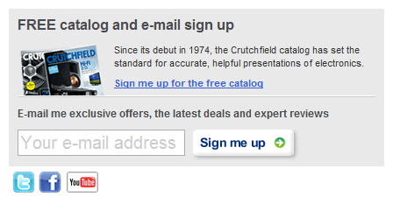
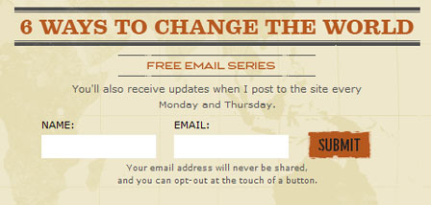
Effective strategies for email marketing
Getting permission for email sign-up
Simply posting “enter your email for updates” isn’t going to get anyone interested to do so.

Slide 24
Effective strategies for email marketing
2. Get Whitelisted
Getting whitelisted is equivalent to being marked as a friend, by being added to the recipient’s address book.
The best way to do this is by providing instructions to do so at the top of each email, especially on the initial thank you and first follow-up email.

Slide 25
Effective strategies for email marketing
3. Manage Expectations with Follow-Up Efforts
Strong call to action
Consistent follow-up.
Maintaining the expected frequency of emails.
Right timing is important

Slide 26
Effective strategies for email marketing
4. Add value to the content
Use a right mix of messages and updates.
For example, while the email might contain a list of product updates and images, it’s balanced by a personal message or friendly update.

Slide 27
Effective strategies for email marketing
5. Segmentation and Analytics
Segmentation gives you the ability to send more targeted communication.
Email Analytics give specific clues as to whether the email marketing efforts are moving in right direction. 3 commonly used analytics:
Open rate: tells you how well you’ve built your relationship; if the number is low, it means that people have started to delete upon receipt and you need to add more value to your content and manage expectations.
Click through rate (CTR): If it is low, it means that your message is either not targeted enough, or simply not getting through.
Unsubscribes: try to examine when people are leaving and take action based on those leaks.

Slide 28
Mobile website configuration
In the USA, 94% of people with smartphones search for local information on their phones*.
The desktop version of a site might be difficult to view and use on a mobile device.
A Mobile website is the mobile-friendly version of the website which can be displayed appropriately on a mobile device.
Main considerations while making a mobile-friendly website:
Make an easy to use mobile site so that it is easier for the customers to complete their tasks using it.
Focus on consistency in your interface and provide a unified experience across platforms.
Ensure that the mobile site is fast and takes less time to load the pages.
Continuously improve by collecting feedback from customers and data from web analytics.
*https://developers.google.com/search/mobile-sites/get-started

Slide 29
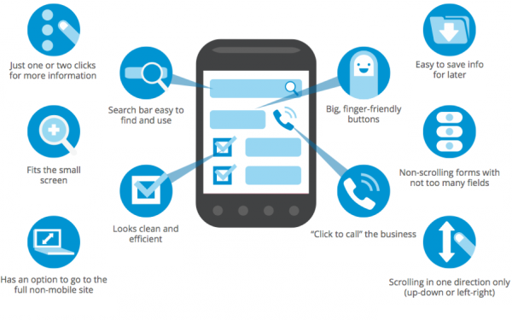

Slide 30
Mobile site configuration
Three main techniques for implementing a website that can handle view screens of all types and sizes:
Responsive web design: Serves the same HTML code on the same URL regardless of the users’ device (desktop, tablet, mobile, non-visual browser), but can render the display differently (i.e., “respond”) based on the screen size. Responsive design is Google’s recommended design pattern.
Dynamic serving: Uses the same URL regardless of device, but separate HTML codes for different device types based on what the server knows about the user’s browser.
Separate URLs: Serves different code to each device, and on separate URLs. This configuration tries to detect the users’ device, then redirects to the appropriate page using HTTP redirects along with the Vary HTTP header.

Slide 31
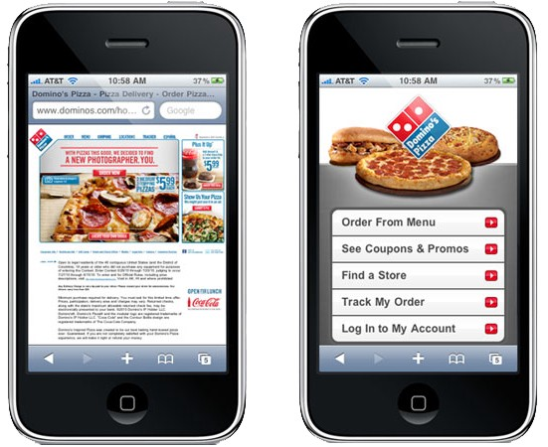

Slide 32
Video marketing using YouTube
YouTube is an American video-sharing website headquartered in San Bruno, California.
Three former PayPal employees—Chad Hurley, Steve Chen, and Jawed Karim—created the service in February 2005.
Google bought the site in November 2006 for US$1.65 billion.
YouTube now operates as one of Google's subsidiaries.
YouTube has over a billion users which is almost a third of ALL people on the internet.
The number of channels earning six figures per year on YouTube grew more than 40% y/y.
YouTube is being used by marketers to enhance brand presence and improve overall SEO.
https://www.youtube.com/intl/en-GB/yt/about/press/

Slide 33
Video Marketing using YouTube
Creating a YouTube channel:
Login using a Gmail ID
Select “Customize channel” to add a Channel Art and Channel Icon
Use images that are easily recognizable and consistent with your overall branding.
Add a channel description, a company email, and links to your company website and other social platforms in the About section.

Slide 34
Types of videos for promotion
1) Customer testimonials
Short-form interviews with satisfied customers. Customer testimonials can help build company and product credibility.
2) On-demand product demonstration videos
Short pieces of content showing the benefits and proper use of a product.
3) Explainer and tutorial videos
In-depth videos explaining how to use a product or various parts of a product or service. Tutorials can be used to answer customer support questions or explain a new product feature.
4) Thought leader interviews
Interviews with experts or thought leaders can help amplify your company’s credibility in an industry.

Slide 35
Types of videos for promotion
5) Project reviews and case studies
Project reviews or case studies recap a successful campaign or project and often include statistics and results.
6) YouTube Live
Allows users to broadcast live content to viewers. Live video allows you to easily share unfiltered moments, and lets your audience participate with real-time comments.
7) Video blogs
Video blogs are daily or weekly videos documenting daily life or events. You could also record a video that gives an overview and the most important tips from a blog post so your audience has multiple ways to digest the content.
8) Event videos
Event videos feature in-person experiences at a conference or expo and can be a great way to show the excitement of a crowd.

Slide 36
How to write a video script
Define Your Goal
Create a Storyboard and Write the Lines
A storyboard is like a blueprint for your video and serves as an outline for the shoot. It includes:
A frame for each major scene or location change.
Basic descriptive information about the scene (time of day, weather, mood of the characters, etc.)
Lines for each scene.
Camera direction for motion and details on if you want tight, medium, or wide shots.
Decide on Additional Multimedia Elements
Plan out the placement and content for graphical pieces in advance. These elements can be incorporated into your storyboards so the video’s content flows seamlessly.
Determine the Length of the Video
On YouTube, videos under two minutes receive the highest levels of engagement.
Pick a Filming Location(s)

Slide 37
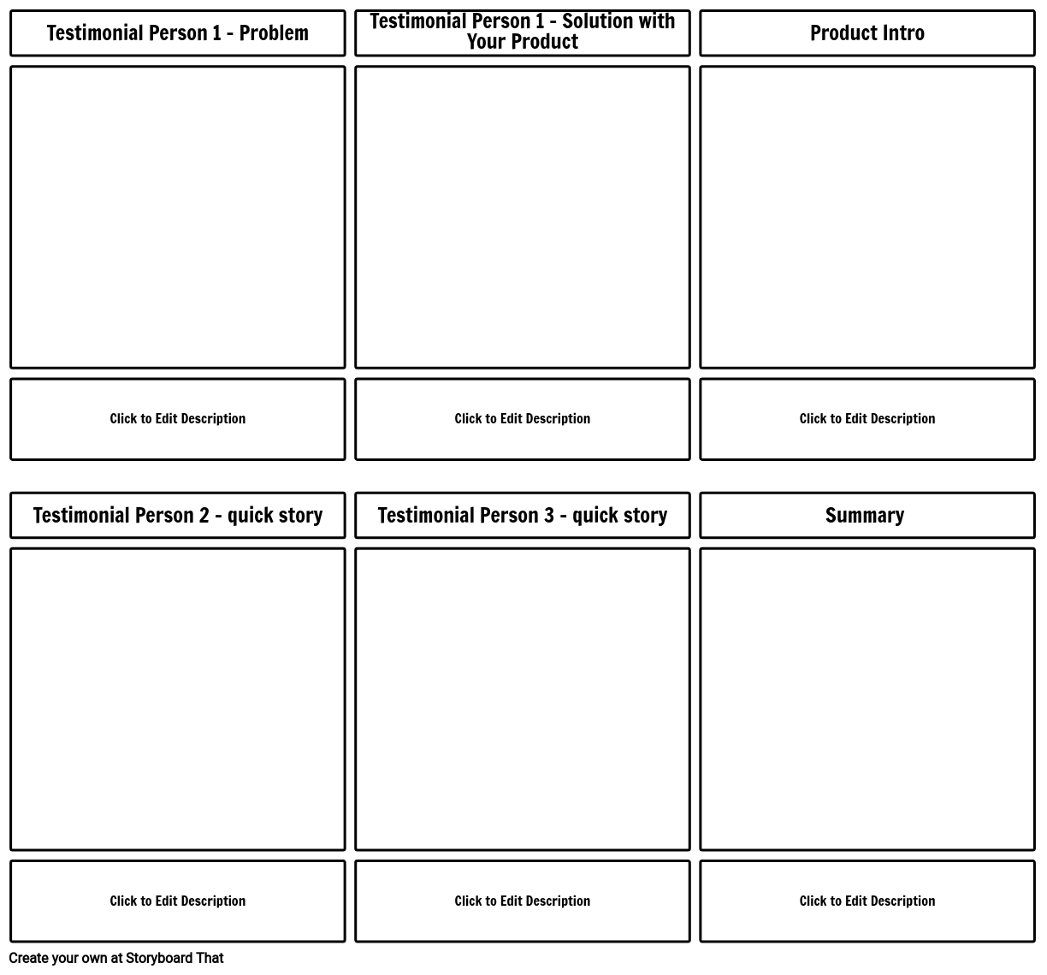

Slide 38
Effective Strategy for video marketing using YouTube
Set a goal. E.g.:
Brand awareness
Drive leads
Improve SEO
Increase conversions
Audience targeting: in-depth knowledge of your target consumers including their tastes, product preferences, disposable income, spending behavior, sites they visit and the type of content they consume.
Create videos that the audience will pay attention to
Engaging
Entertaining
Valuable
Useful
Answer the needs of your audience
Do keyword research

Slide 39
Effective Strategy for video marketing using YouTube
Use annotations and cards
Annotations are clickable links that you can insert into your videos
Cards are more professional version of annotations. It might be included as a rectangular box containing more information and clickable links.
Choose relevant thumbnail
Cross-promote your video by sharing links on other platforms such as
Write a blog and include it within your post
Email your database that sends a link back to your video
Upload it to your social channels
Outreach to relevant influencers and ask them if they would share it
Write a guest post surrounding the content of your video and link back to it
Pay to advertise your video and YouTube channel
Monitor the performance using analytics

Slide 40
Optimisation of videos
Optimization helps to rank highly on both YouTube and in Google search results.
Identify the right keyword for your channel by applying keyword research.
Optimize the metadata for the YouTube videos.
Providing the right information in your video’s metadata will help to ensure that it is properly indexed by YouTube and appears when people are searching for videos like yours.
Adopt a mobile-first mindset

Slide 41
Optimisation of videos
Metadata gives viewers information about the video, which includes:
Video title: Include the most important information and keywords in the beginning of your title. Keep titles to around 60 characters
Description: YouTube will only show the first two to three lines (about 100 characters) of video’s description, then viewers will need to click “show more” to see the rest. For that reason, be sure to include any important links or CTAs in the beginning of your description
Tags: highlight your main keywords in your tags.
Category: After you upload a video, YouTube will allow you to choose a video category under “Advanced settings.”
Thumbnail: YouTube will auto-generate a few thumbnail options for your video, but it is recommended to upload a custom thumbnail.
Subtitles and closed captions: add subtitles or closed captions by uploading a supported text transcript or timed subtitles file.

Slide 42
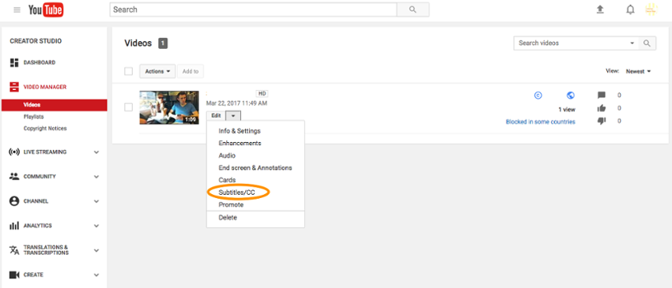
Adding subtitles and captions

Slide 43
Tips and tricks for promotion
Provide good quality relevant content
Create and publish short, fun videos which have a high propensity of going viral
Embed videos on homepage and other pages of website.
Share videos on social media using a variety of social media channels including Facebook, Twitter, LinkedIn and Google+
YouTube retargeting: Re-advertising to viewers who showed interest in your brand by watching a video
Include videos in emails
Promote your video through influencers who will act as your brand advocates.
Focus on entertaining than advertising : Video ads can be used for advertisement, use video marketing for customer engagement.
Create interesting thumbnails, channel art, icon, title and description.
Use tags correctly.
Add in-stream call-to-actions and inspire viewers to subscribe.
Maximize engagement by encouraging viewers to like, share and comment on your videos.

Slide 44
YouTube Analytics
YouTube Analytics provide insights to monitor and improve the performance of videos. There are three main parts of the YouTube Analytics dashboard:
Realtime - To see how many people are watching your channel and views on the top few videos with estimated real time views.
Watch time reports - Watch time is the total number of minutes someone watches of your video. In these reports, you can break down how many minutes people are watching, some information about who these viewers are, where they’re discovering you from, and what parts of your video keep their attention or cause them to leave.
Interaction reports - To see how viewers respond to your videos - do they like or dislike them? Which ones got them talking in the comments that were shared with their friends on social media or, added to a playlist on their channel? Did they click on additional features you’ve added to your videos like cards?

Slide 45
YouTube Analytics
Some useful metrics are:
1. Views: Direct indicator of video’s success.
2. Watch Time: the estimated total minutes spent viewing the content
3. Impressions: how many times your video thumbnails are shown on YouTube
4. Impressions Click Through Rate: what percentage of your impressions on YouTube turned into views.
5. Average view duration: To see if people are watching your video all the way to the end or cutting before your video is finished.
6. Demographics Report: Gender-wise and Location-wise breakdown of data
7. Playback locations report: Shows the sites your videos are being viewed on. This is a great way to see if people are embedding your videos on their sites or blogs and what those sites are.
8. Traffic sources: to see how people are finding your videos. Types of traffic sources include YouTube search, YouTube suggested videos (found within YouTube by clicking a thumbnail), YouTube channel page, and YouTube playlist.
9. Devices: This report lets you know what devices and operating systems people are watching your videos on.
10. Audience retention: See how much of your video is being watched and, on average, when people are turning it off.

Slide 46
YouTube Analytics
11. Subscribers: See how many people have subscribed and unsubscribed to your channel
12. Likes and dislikes: To see how people are responding to your videos
13. Favorites: This report shows both when a video was marked as a favorite and also when it was unmarked.
14. Comments: See how many comments each of your videos has received.
15. Sharing: This report shows you the number of times your video has been shared
16. Annotations: This report provides details of the activity, click-through data, and close rates for each annotation you add to your videos.
17. Revenue report: gives you an overview of the different types of revenue streams, including estimated ad revenue and estimated revenue from YouTube Premium.
18. Ad rates report: gives you a detailed breakdown of how each much money each type of ad is bringing into your channel.

Slide 47
Monetizing YT Channel
The YouTube Partner Programme (YPP) lets creators monetise their content on YouTube.
Creators can earn money from advertisements served on their videos and from YouTube Premium subscribers watching their content.
One has to apply to join the YouTube Partner Programme from the account in YouTube Studio.
Programme threshold: Once a channel reaches 4000 watch hours in the previous 12 months and 1000 subscribers, it will be reviewed to join the programme.
Once approved, you'll start earning money on YouTube right away by chosing the videos that you want to monetise.

Slide 48
References
https://mailchimp.com/resources/email-marketing-field-guide/
https://optinmonster.com/beginners-guide-to-email-marketing/
http://www.marketing-schools.org/types-of-marketing/newsletter-marketing.html
https://support.google.com/youtube/answer/1646861?hl=en
https://developers.google.com/search/mobile-sites/mobile-seo/
https://www.wyzowl.com/how-to-effectively-use-youtube-for-video-marketing/
https://www.hubspot.com/youtube-marketing
https://www.ngdata.com/youtube-video-marketing-tips/
https://biteable.com/blog/uncategorized/how-to-get-200000-views-to-your-youtube-channel/
https://creatoracademy.youtube.com/page/lesson/engagement-analytics?cid=analytics-series&hl=en#strategies-zippy-link-4

